Slide 1
File Management Systems
File system, file attributes and operations, file access methods, file allocation techniques

Slide 2
Definition
File Management is the process by which an operating system organizes, stores, retrieves, and manages data in the form of files on storage devices like hard drives, SSDs, and external drives.
It provides a systematic way to access and organize data while ensuring data security, reliability, and efficient utilization of storage resources

Slide 3
Objectives
Data Organization: Store data in a structured way for easy access.
Access Control: Manage permissions for users and processes.
Storage Optimization: Maximize storage utilization while minimizing fragmentation.
Reliability: Ensure data integrity and recovery from errors.

Slide 4
Key Components of File Management
File Naming:
Assigns unique names to files for identification.
Handles extensions to indicate file types (e.g., .txt, .doc).
File Structure:
Organizes data within files (e.g., sequential, indexed, hierarchical structures).
File Operations:
Basic operations: Create, Read, Write, Delete, Append, Rename.
Advanced operations: Copy, Move, Compress, Encrypt.

Slide 5
Key Components of File Management
File Directories:
Hierarchical structure for organizing files into folders and subfolders.
Types: Single-level, Two-level, Tree-structured, Acyclic Graph, General Graph.
File Access Methods:
Sequential Access: Access data in a specific order.
Direct Access: Access data using specific addresses.
Indexed Access: Use an index to locate data efficiently.

Slide 6
File Allocation Techniques Overview
Definition: File allocation is the method used by the operating system to manage and organize the storage of files on a disk.
Objective:
Efficiently utilize storage space.
Facilitate quick and reliable file access.
Minimize fragmentation and management overhead.

Slide 7
File Allocation Techniques
Contiguous Allocation:
Stores files in contiguous blocks.
Pros: Fast access; Cons: Fragmentation.
Linked Allocation:
Uses pointers to link non-contiguous blocks.
Pros: No external fragmentation; Cons: Slower access.
Indexed Allocation:
Uses an index block to track file blocks.
Pros: Direct access; Cons: Overhead for index blocks.

Slide 8
Contiguous Allocation
Description:
Allocates a single continuous set of disk blocks for a file.
The file occupies consecutive sectors on the disk.
Advantages:
Fast Access: Easy and quick to access data sequentially and randomly.
Simple Implementation: Minimal metadata is needed (start block and length).
Disadvantages:
Fragmentation: Over time, free spaces may become fragmented, making it hard to find contiguous blocks.
Difficult Expansion: File size cannot grow unless there is adjacent free space.
Storage Utilization: May waste space due to pre-allocation for growth.
Use Cases:
Suitable for applications requiring fast sequential access, like video playback.
Example:
A file of size 3 KB is allocated starting from block 5. It occupies blocks 5, 6, and 7.

Slide 9
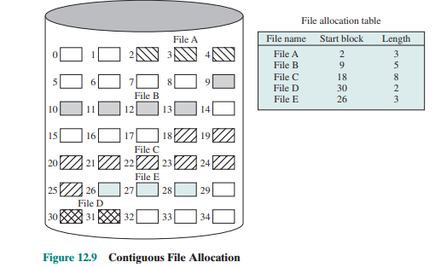
Contiguous Allocation

Slide 10
Linked Allocation
Description:
Each file is a linked list of disk blocks, and each block contains a pointer to the next block.
The directory entry contains the starting block number.
Advantages:
No External Fragmentation: Blocks can be scattered anywhere on the disk.
Dynamic File Size: Can easily grow by adding more blocks.
Disadvantages:
Slow Access: Sequential access requires traversing pointers; random access is not efficient.
Pointer Overhead: Some disk space is used to store pointers.
Reliability Issues: If a pointer is lost or corrupted, the file may be partially or entirely inaccessible.
Use Cases:
Suitable for applications where files frequently grow or shrink, such as logs.

Slide 11
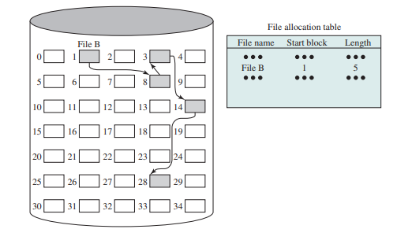
Linked Allocation

Slide 12
Indexed Allocation
Description:
Uses an index block that stores pointers to all the blocks of a file.
The directory entry points to the index block.
Advantages:
Direct Access: Random access is efficient as all block addresses are available in the index.
No Fragmentation: Like linked allocation, blocks can be scattered.
Disadvantages:
Index Block Overhead: Requires additional space for the index block.
Limited File Size: The number of blocks a file can have is limited by the size of the index block.

Slide 13
Indexed Allocation
Variations:
Single-level Indexing: One index block per file.
Multi-level Indexing: Uses additional index blocks for very large files (e.g., in ext4).
Combined Scheme: Combines direct, single-level, and multi-level indexing (e.g., in UNIX).
Use Cases:
Suitable for systems requiring fast access to files of varying sizes, like databases.
Example:
A file with blocks 5, 9, 12 has an index block containing pointers to these blocks.

Slide 14
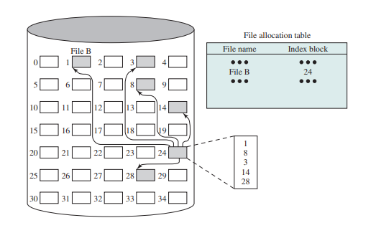
Indexed Allocation

Slide 15
Importance of File Management
Efficiency: Ensures fast and reliable data access.
Security: Protects sensitive data through permissions and encryption.
Data Integrity: Reduces risks of data corruption and loss.
Scalability: Supports large volumes of data and multiple users.

Slide 16
Modern Examples of File Management Systems
Windows File System: NTFS, FAT32.
Linux File System: ext3, ext4, XFS.
Cloud Storage: Distributed file systems like Google File System (GFS), Hadoop Distributed File System (HDFS).

